Slide 1
INTRODUCTION TO MACHINE LEARNING
Zhao Yuqing

Slide 2
WORKSHOP OUTLINE
Overview
Introduction
Data Types
2. Supervised Machine Learning
Classification & Regression in ML
Linear Regression
Logistic Regression
Decision Trees
Regression & Classification Metrics
3. Unsupervised Machine Learning
Clustering
K-Means
Gaussian-Mixture

Slide 3
OVERVIEW
01

Slide 4
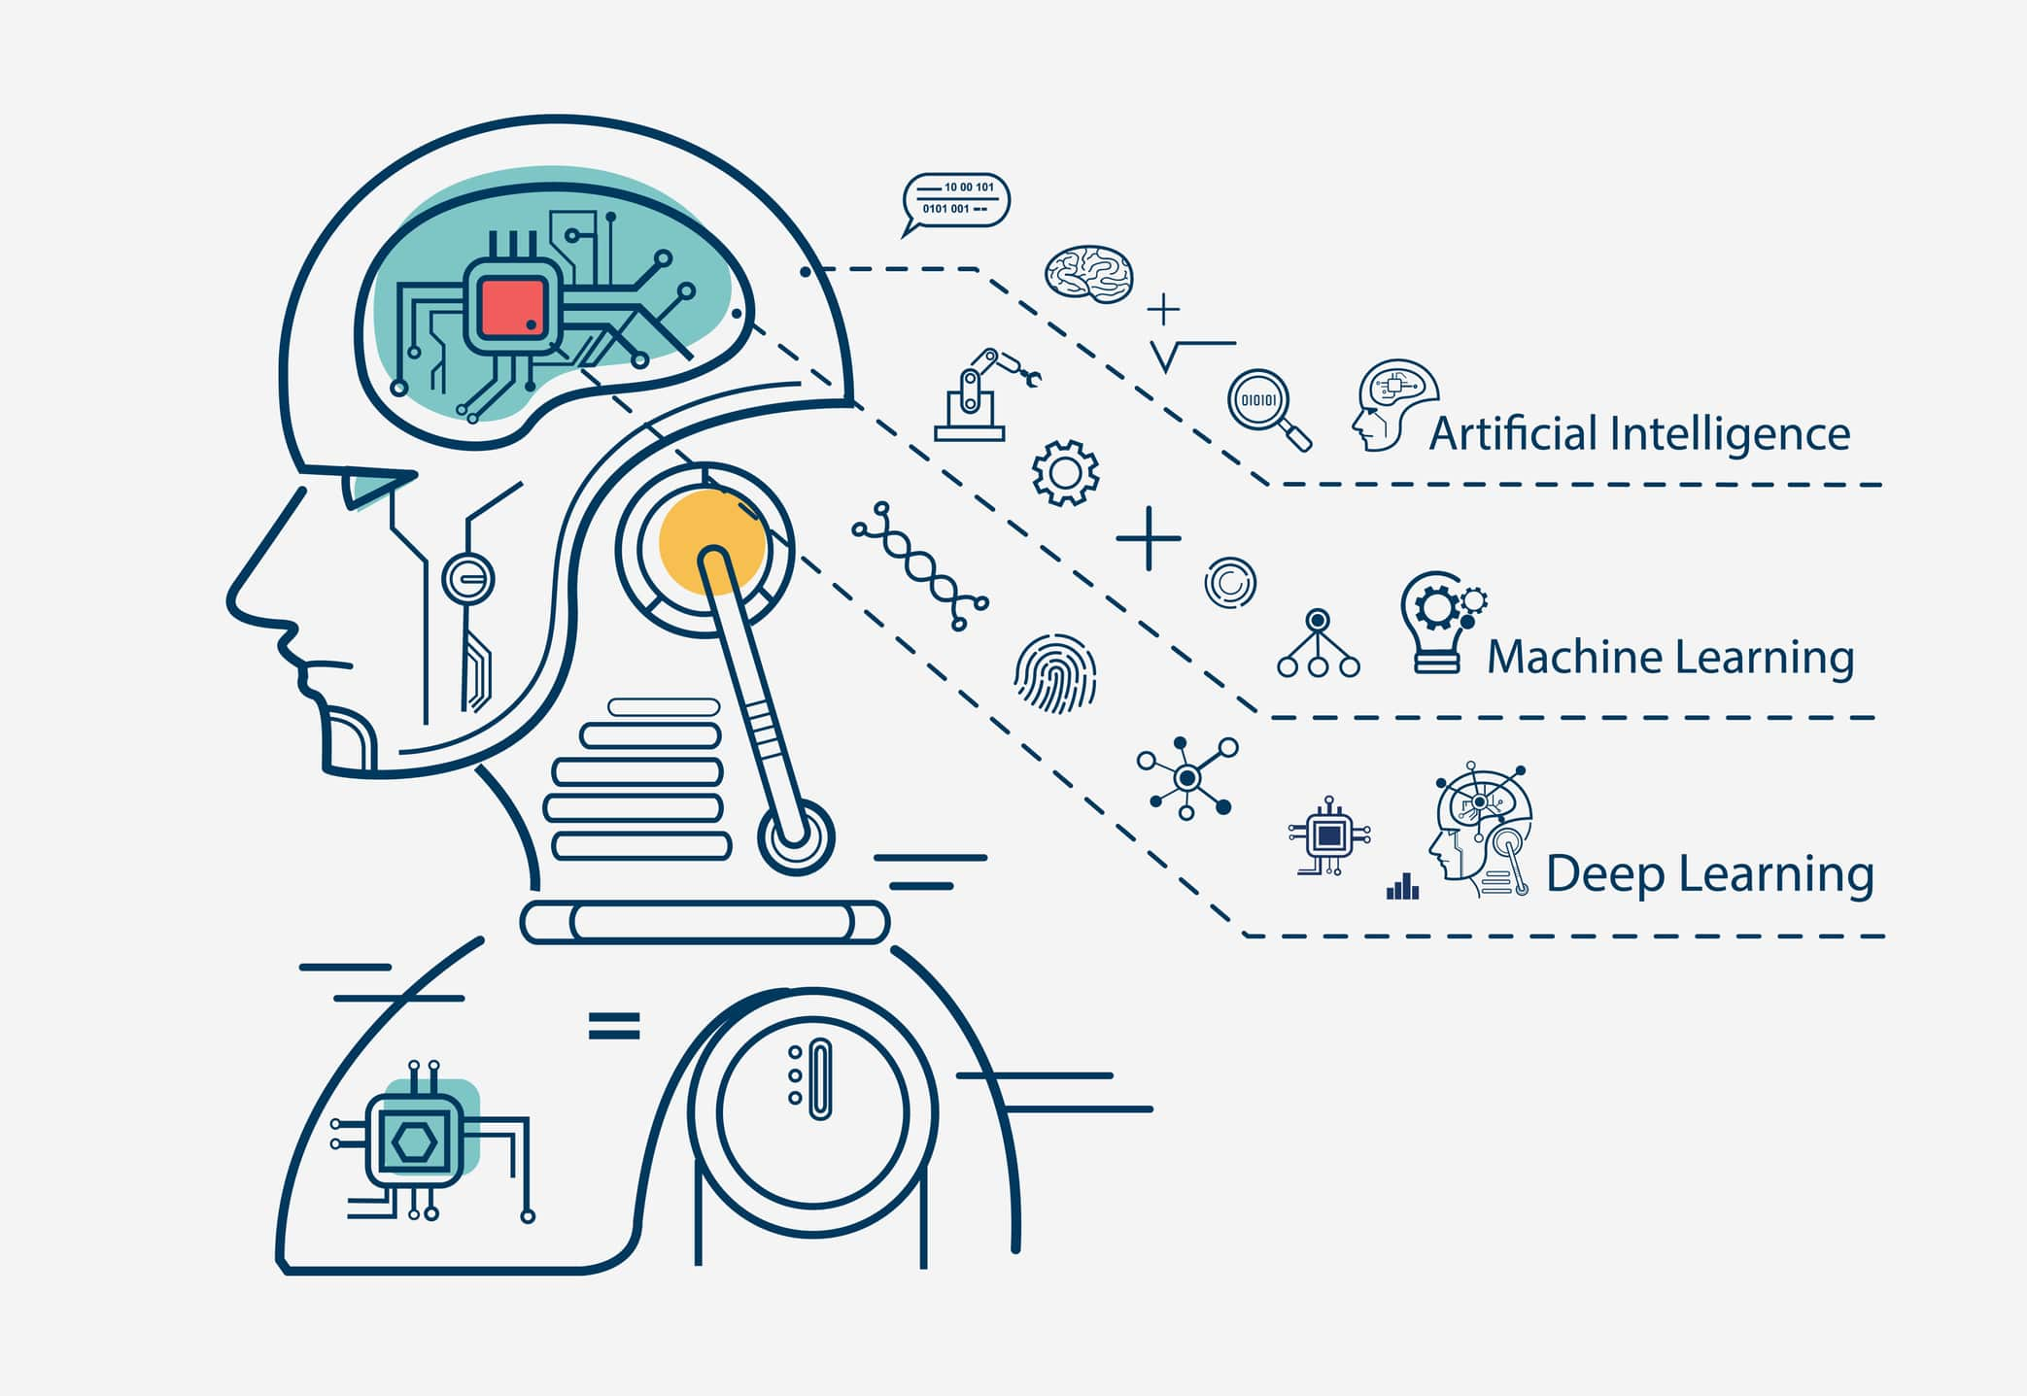
Introduction
https://www.youtube.com/watch?v=ukzFI9rgwfU&ab_channel=Simplilearn

Slide 5
Introduction
Machine learning (ML) is a field of inquiry devoted to understanding and building methods that 'learn', that is, methods that leverage data to improve performance on some set of tasks.
Machine learning algorithms are used in a wide variety of applications, such as in medicine, email filtering, speech recognition, and computer vision, etc.

Slide 6
Relative Keywords
AI
ML learns and predicts based on passive observations, whereas AI implies an agent interacting with the environment to learn and take actions that maximize its chance of successfully achieving its goals.
As of 2020, many sources continue to assert that ML remains a subfield of AI. Others have the view that not all ML is part of AI, but only an 'intelligent subset' of ML should be considered AI.
Data Mining
Machine learning and data mining often employ the same methods and overlap significantly, but while machine learning focuses on prediction, based on known properties learned from the training data, data mining focuses on the discovery of(previously) unknown properties in the data (this is the analysis step of knowledge discovery in databases).

Slide 7
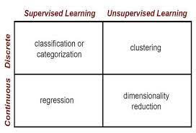
Supervised vs Unsupervised vs Reinforcement
Supervised Learning Models are trained using labelled data.
The computer is presented with example inputs and their desired outputs, given by a "teacher", and the goal is to learn a general rule that maps inputs to outputs.
Unsupervised Learning Models are trained using unlabelled data.
No labels are given to the learning algorithm, leaving it on its own to find structure in its input. Unsupervised learning can be a goal in itself (discovering hidden patterns in data) or a means towards an end – Feature learning.

Slide 8
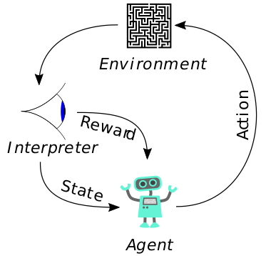
Supervised vs Unsupervised vs Reinforcement
Reinforcement learning is a computer program interacts with a dynamic environment in which it must perform a certain goal (such as driving a vehicle or playing a game against an opponent).
As it navigates its problem space, the program is provided feedback that's analogous to rewards, which it tries to maximize.

Slide 9
Data Types
Categorical
Data that can be divided into groups
Example: Age, Race, Gender
Numerical
Values represented by numbers, either integers or decimals
Time-Series
Series of data points indexed in time order
Example: Revenue over a time period, Stock price over a time period
Text
Words, Sentences
Example: Customer Reviews

Slide 10
02
SUPERVISED MACHINE LEARNING

Slide 11
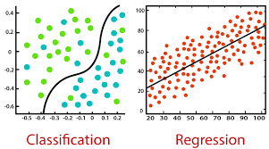
Classification & Regression
Classification is about predicting a discrete class label while Regression is about predicting a continuous quantity
A classification algorithm predicts the probability of a class label based on the inputs
Classification predictions can be evaluated using accuracy, whereas regression predictions cannot
https://www.youtube.com/watch?v=xYJEM2C0G5Q&ab_channel=TheDataPost

Slide 12
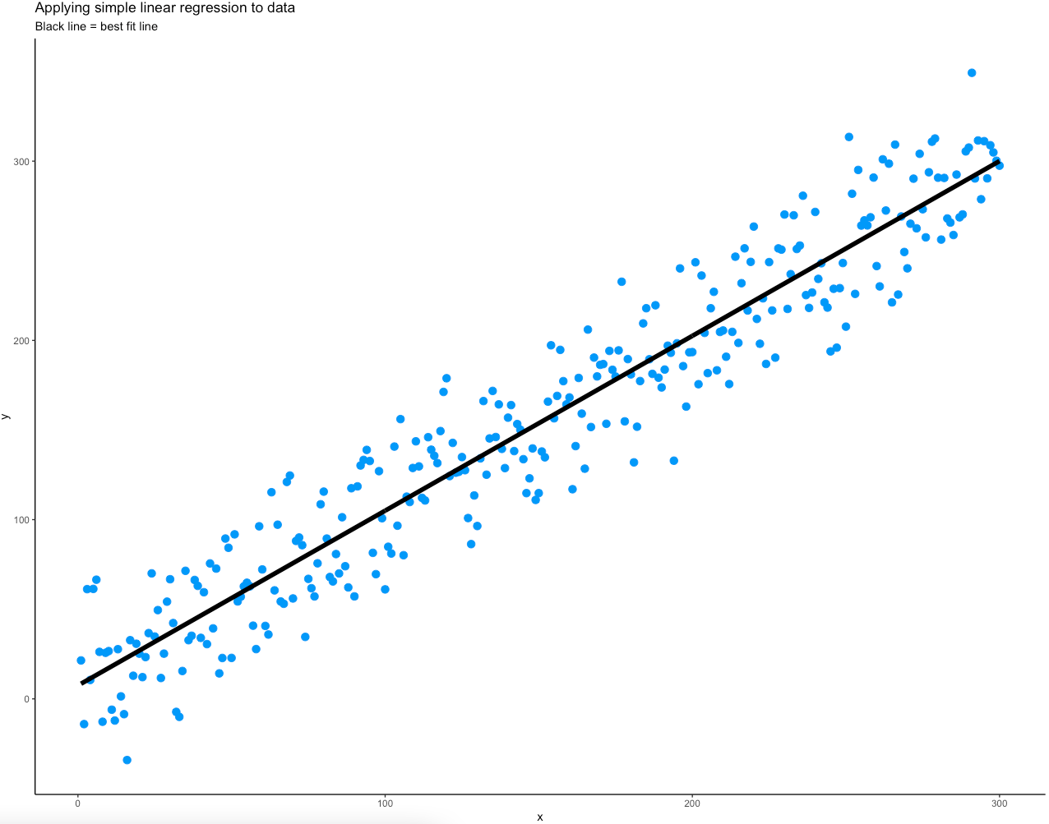
Linear Regression
Linear Regression is a model where we try to establish a linear relationship between a dependent variable y and one or more dependent variable X
The objective is to fit the best fit of a straight line that will try to minimize the error between the expected value predicted value
https://www.youtube.com/watch?v=zPG4NjIkCjc&ab_channel=statisticsfun

Slide 13
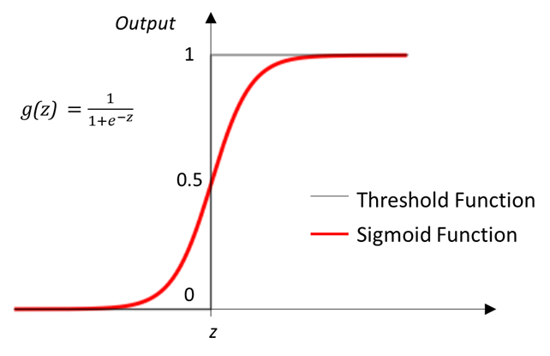
Logistic Regression
Implemented for Binary Classification Problems
A linear relationship is first established between y and X and then passed into the sigmoid function
The output is the estimated probability of the data belonging to a class label.
Default threshold value used is 0.5 to determine the class labels

Slide 14
Linear vs Logistic Regression
Linear Regression | Logistic Regression
Used for Regression Problems Regression line is linear Output is continuous | Used for Binary Classification Problems Regression line follows the sigmoid function Output is Continuous but represents the probability of the data belonging to the discrete binary class label (0 or 1)

Slide 15
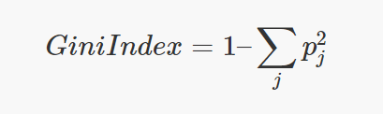
Decision Trees (CART)
Decision Tree is a Supervised Learning Model that can be used in classification and regression Problems
The CART Algorithm is one of the most common way to split Decision Trees based on the Gini Impurity as it requires less computational power
Gini Index (Gini Impurity) measures the ‘impurity’ of a node

Slide 16
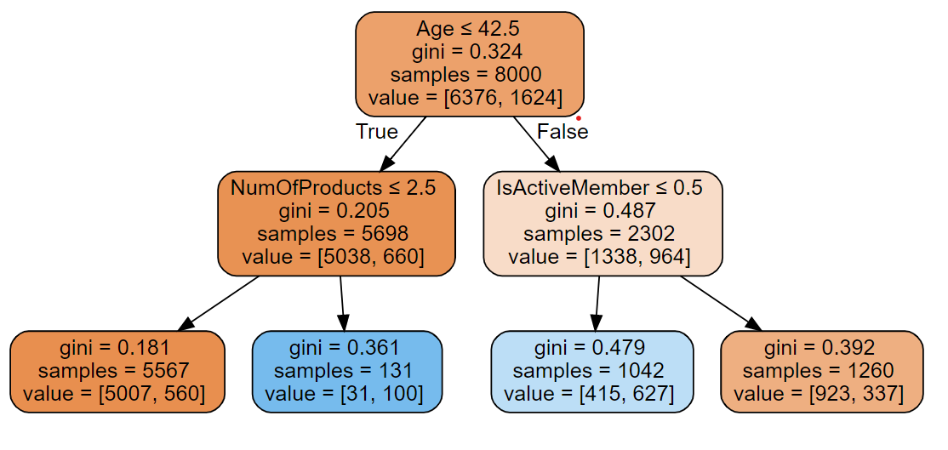
Decision Trees (CART)
The goal of a Decision Tree is to reach a pure node, that is when gini index is 0
this means that all the elements in the node are of one unique class.
The optimum split is chosen by the features with lowest Gini Impurity. The Decision Tree Algorithm loops through every single variable and every single value of the variable possible

Slide 17
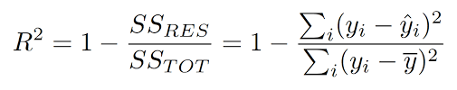
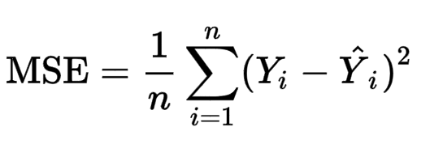
Regression Metrics
Metric | Description
R^2 | Values between 0 and 1 Measure of how regression line fit the actual values A higher R^2 value generally means that the model is a better fit
Mean Square Error (MSE) | Average of the square of the errors between predicted and expected values The larger the MSE the larger the error present in the Regression Model

Slide 18
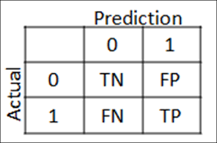
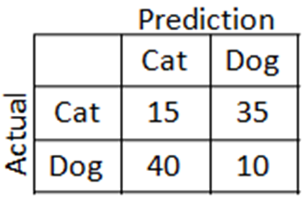
Classification Metrics
Accuracy = (TP+TN)/N
N = TP + TN + FN + FP
Accuracy = (15+10)/100 = 0.25

Slide 19
Classification Metrics
Metric |  | Description
Precision | TP/(TP+FP) | When FP is much more important For example, wrongly classifying a normal email as spam (False Positive) might make a user miss a important email
Recall | TP/(TP+FN) | When FN is much more important For example, wrongly classifying a covid-19 patient as negative (False Negative) is detrimental
F1-Score | 2*(Precision+Recall)/(Precision*Recall) | Harmonic Mean between Precision and Recall Measure of a model’s accuracy

Slide 20
03
UNSUPERVISED MACHINE LEARNING

Slide 21
~ Yan Lecun, VP and Chief AI scientist at Facebook
Unsupervised learning - teaching machines to learn for themselves without the need to be explicitly told if everything they do is right or wrong - is the “true AI”

Slide 22
What is Unsupervised Learning?
Data given to the algorithm is not labelled, i.e only input variables (x values) are given without their corresponding output variables (y values).
Algorithms are left to discover interesting structures in the data on their own without the user’s inputs/observations.

Slide 23
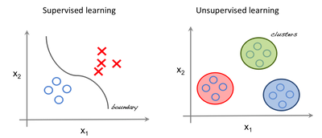
Supervised vs. Unsupervised Learning
Supervised - we use regression techniques to find the best fit line between the features.
Unsupervised - inputs are segregated based on features and prediction is based on which cluster it belongs to.

Slide 24
Important Terminology
Feature: An input variable used in making predictions.
Predictions: A model’s output when provided with an input example.
Example: One row of a dataset. An example contains one or more features and possibly a label.
Label: Result of a feature.

Slide 25
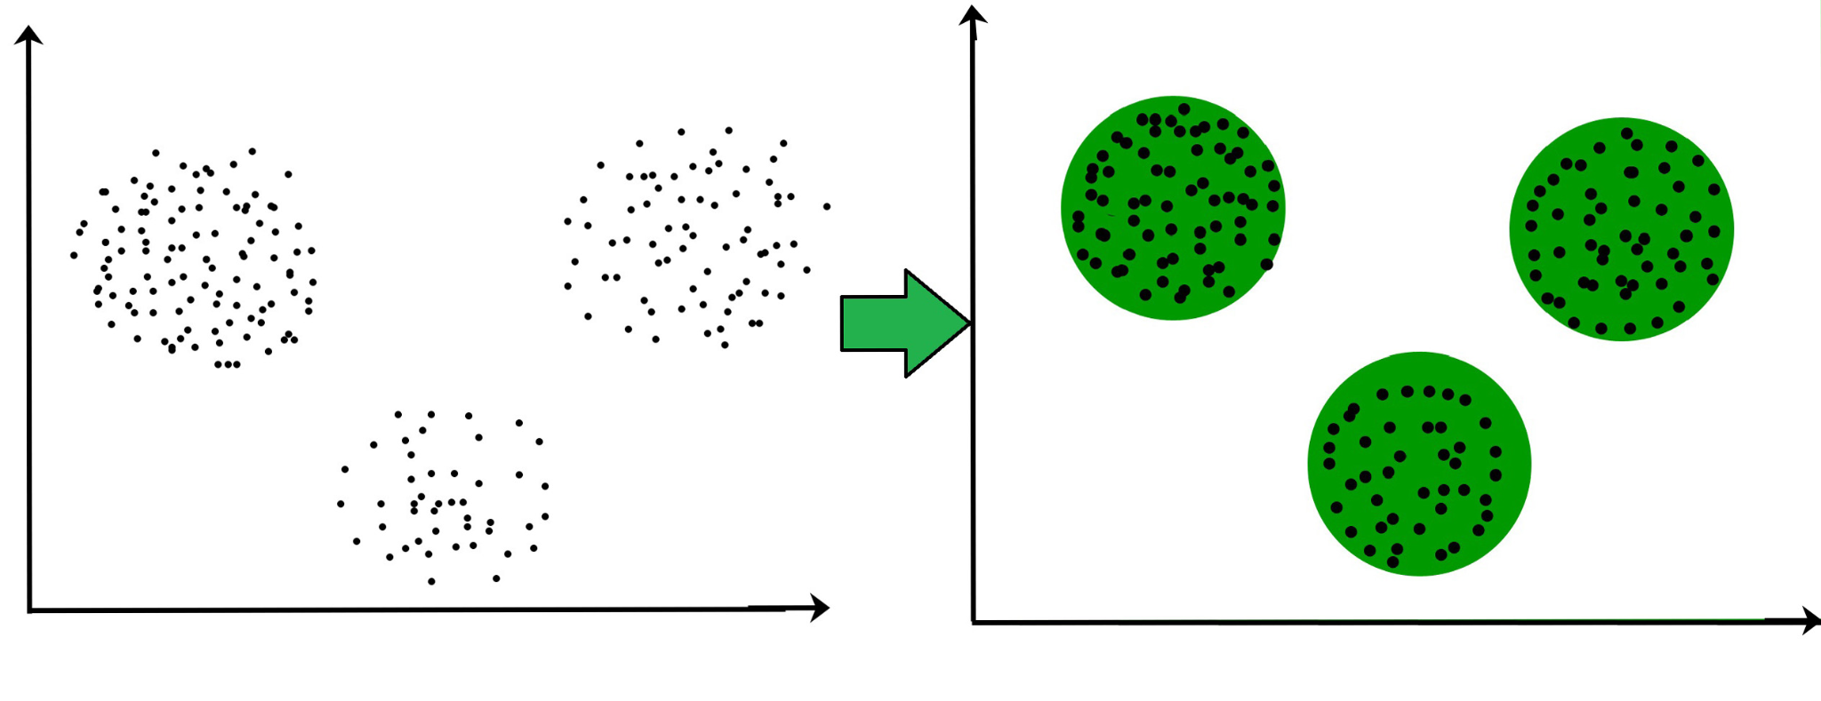
Clustering in Unsupervised Learning
It is the process of grouping similar entities together. The goal of this unsupervised machine learning technique is to find similarities in the data point and group similar data points together.
https://www.youtube.com/watch?v=kM5ttbLc5b8&ab_channel=Dataiku

Slide 26
Types of Clustering
K-Means
Mixture of Gaussians
Spectral
Mean Shift etc.

Slide 27
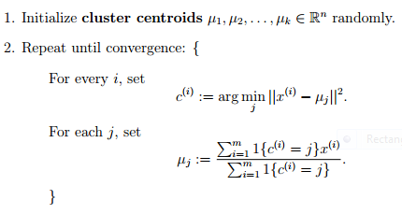
K-Means
In this algorithm, we have to tell the algorithm how many possible clusters ( or K ) there are in the dataset. The algorithm then iteratively moves the k-centers and selects the data points that are closest to the centroid in the cluster.

Slide 28
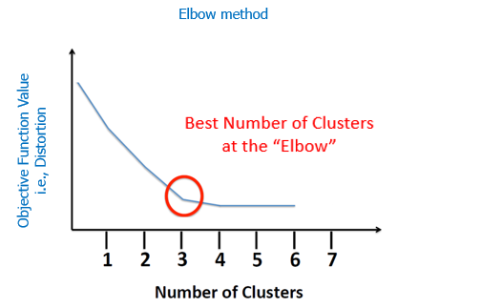
# How to find the K-value
Elbow Method
The x-axis is the K-value and the y-axis is some objective function. A common objective function is the average distance between the data points and the nearest centroid.
The best number for K is the “elbow” or kinked region. After this point, it is generally established that adding more clusters will not add significant value to our analysis

Slide 29
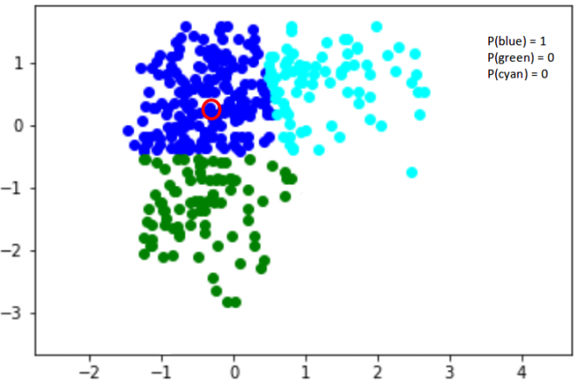
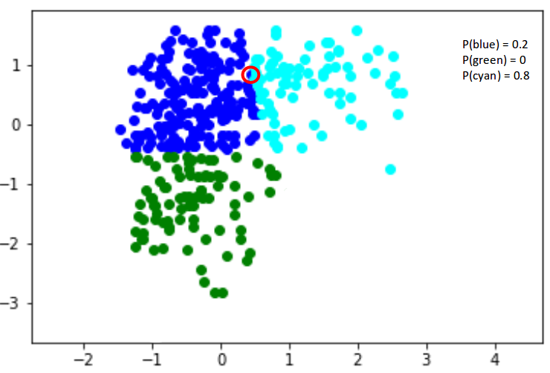
Gaussian Mixture Model
It is a probabilistic model that uses the soft clustering approach for assigning data points to Gaussian distributions.
https://www.youtube.com/watch?v=q71Niz856KE&ab_channel=Serrano.Academy

Slide 30
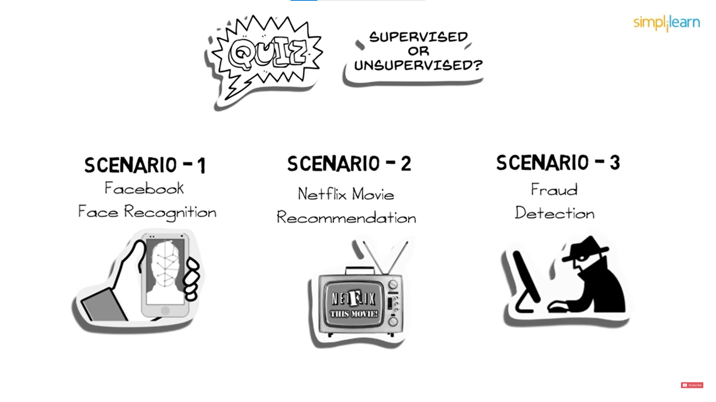

Notes:
Scenario 1: Facebook recognizes your friend in a picture from an album of tagged photographs
Explanation: It is supervised learning. Here Facebook is using tagged photos to recognize the person. Therefore, the tagged photos become the labels of the pictures and we know that when the machine is learning from labeled data, it is supervised learning.
Scenario 2: Recommending new songs based on someone’s past music choices
Explanation: It is supervised learning. The model is training a classifier on pre-existing labels (genres of songs). This is what Netflix, Pandora, and Spotify do all the time, they collect the songs/movies that you like already, evaluate the features based on your likes/dislikes and then recommend new movies/songs based on similar features.
Scenario 3: Analyze bank data for suspicious-looking transactions and flag the fraud transactions
Explanation: It is unsupervised learning. In this case, the suspicious transactions are not defined, hence there are no labels of "fraud" and "not fraud". The model tries to identify outliers by looking at anomalous transactions and flags them as 'fraud'.

Slide 31
THANK YOU
Do you have any questions?

